Slide 1
9. Linear Regression and Correlation
Data: y – a quantitative response variable
x – a quantitative explanatory variable
(Chap. 8: Recall that both variables were categorical)
For example,
y = annual income, x = number of years of education
y = college GPA, x = high school GPA (or perhaps SAT)
We consider:
Is there an association? (test of independence)
How strong is the association? (uses correlation)
How can we describe the nature of the relationship, e.g., by using x to predict y? (regression equation, residuals)

Slide 2
Linear Relationships
Linear Function (Straight-Line Relation):
y = α + β x
expresses y as linear function of x with slope β and y-intercept α.
    For each 1-unit increase in x, y increases β units
    β > 0 ⇒ Line slopes upward (positive relationship)
    β = 0 ⇒ Horizontal line (y does not depend on x)
    β < 0 ⇒ Line slopes downward (negative relation)

Slide 3
Example: Economic Level and CO2 Emissions
OECD (Organization for Economic Development, www.oecd.org): Advanced industrialized nations “committed to democracy and the market economy.”
oecd-data file (from 2004) on p. 62 of text and at text website www.stat.ufl.edu/~aa/social/
Let y = carbon dioxide emissions (per capita, in metric tons)
Ranges from 5.6 in Portugal to 22.0 in Luxembourg
mean = 10.4, standard deviation = 4.6
x = gross domestic product (GDP, in thousands of dollars per capita)
Ranges from 19.6 in Portugal to 70.0 in Luxembourg
mean = 32.1, standard deviation = 9.6

Slide 4
The relationship between x and y can be approximated by
y = 0.42 + 0.31x.
At x = 0, predicted CO2 level y = 0.42 + 0.31x = 0.42 + 0.31(0) = 0.42 (irrelevant, because no GDP values near 0)
At x = 39.7 (value for U.S.), predicted CO2 level
y = 0.42 + 0.31(39.7) = 12.7 (actual = 19.8 for U.S.)
For each increase of 1 thousand dollars in per capita GDP, CO2 use predicted to increase by 0.31 metric tons per capita
But, this linear equation is just an approximation. The correlation between x and y for these nations was 0.64, not 1.0
(It is even less, 0.41, if we take out the outlier observation for Luxembourg.)
Likewise, we would not expect to be able to predict annual income perfectly using years of education or to predict college GPA perfectly using high school GPA.

Slide 5
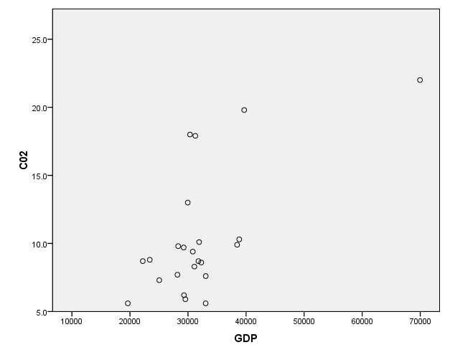

Slide 6
Effect of variable coding?
Slope and intercept depend on units of measurement.
If x = GDP measured in dollars (instead of thousands of dollars), then
y = 0.42 + 0.00031x
because a change of $1 has only 1/1000 the impact of a change of $1000 (so, the slope is multiplied by 0.001).
If y = CO2 output in kilograms instead of metric tons
(1 metric ton = 1000 kilograms), with x in dollars, then
y = 1000(0.42 + 0.00031x) = 420 + 0.31x
Suppose x changes from U.S. dollars to British pounds and 1 pound = 2 dollars. What happens?

Slide 7
Probabilistic Models
In practice, the relationship between y and x is not “perfect” because y is not completely determined by x. Other sources of variation exist.
  We let α + β x represent the mean of y-values, as a function of x.
  We replace equation
  y = α + β x by E(y) = α + β x (for population)
  (Recall E(y) is the “expected value of y”, which is the mean of its probability distribution.)
  e.g., if y = income, x = no. years of education, we regard E(y) = α + β(12) as the mean income for everyone in population having 12 years education.

Slide 8
A regression function is a mathematical function that describes how the mean of the response variable y changes according to the value of an explanatory variable x.
A linear regression function is part of a model (a simple representation of reality) for summarizing a relationship. A linear model is OK if the true relationship is approximately linear, not OK if highly nonlinear.
In practice, we use data to check whether a particular model is plausible (e.g., by looking at a scatterplot) and to estimate model parameters.

Slide 9
Estimating the linear equation
A scatterplot is a plot of the n values of (x, y) for the n subjects in the sample
Looking at the scatterplot is first step of analysis, to check whether linear model seems plausible
Example: Are externalizing behaviors in adolescents (e.g., acting out in negative ways, such as causing fights) associated with feelings of anxiety?
(Nolan et al., J. Personality and Social Psych., 2003)

Slide 10
Data (some)
Subject Externalizing (x) Anxiety (y)
1 9 37
2 7 23
3 7 26
4 3 21
5 11 42
6 6 33
7 2 26
8 6 35
9 6 23
10 9 28
As exercise, conduct analyses with x, y reversed

Slide 11
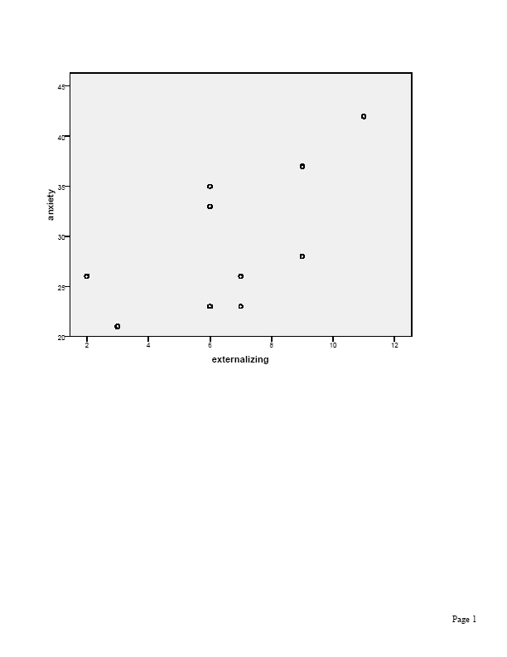
Variables
Anxiety (y) Externalizing (x)
mean 29.4 6.6
std. dev. 7.0 2.7

Slide 12

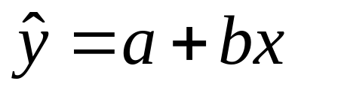
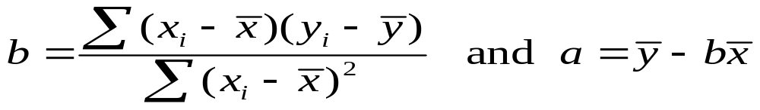
How to choose the line that “best fits” the data?
  Criterion: Choose line that minimizes sum of squared vertical distances from observed data points to line. This is called the least squares prediction equation.
  Solution (using calculus):
  Denote estimate of  by a, estimate of  by b, estimate of E(y) and the prediction for y by . Then,
  with

Slide 13
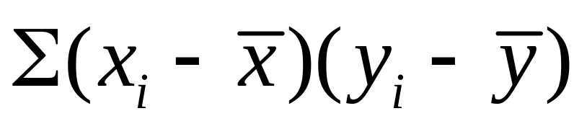
Example: What causes b > 0 or b < 0?
Subject Externalizing (x) Anxiety (y)
1 9 37
2 7 23
Numerator of b is
The contribution of subjects 1 and 2 to b is
(9 - 6.6)(37 - 29.4) + (7 - 6.6)(23 - 29.4)
positive negative

Slide 14


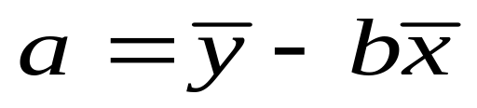
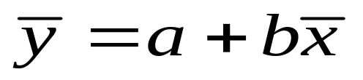
Motivation for formulas:
If observation has both x and y values above means, or both values below means, then
(x - )(y - ) is positive. Slope estimate b > 0 when most observations like this.
means that
i.e., predicted value of y at mean of x is mean of y. The prediction equation passes through the point with coordinates ( , ).

Slide 15
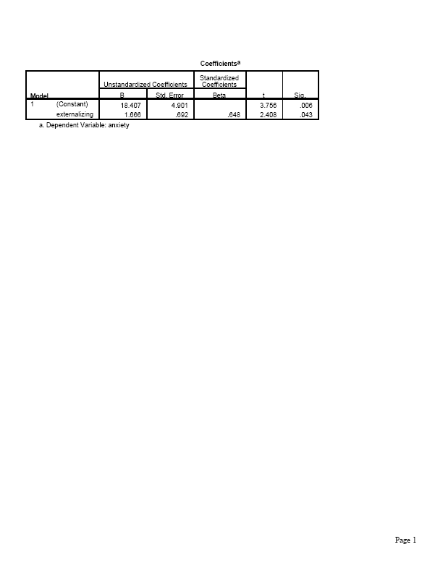
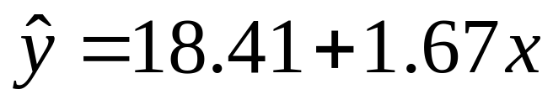
Results for anxiety/externalizing data set
Least squares estimates are
a = 18.407 and b = 1.666.
That is,

Slide 16
Interpretations
1-unit increase in x corresponds to predicted increase of 1.67 in anxiety score.
y-intercept of 18.4 is predicted anxiety score for subject having x = 0.
The value b = 1.67 > 0 corresponds to a positive sample association between the variables.
… but, sample size is small, with lots of variability, and it is not clear there would be a positive association for a corresponding population.

Slide 17
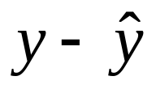
Residuals (prediction errors)
For an observation, difference between observed value of y and predicted value of y,
is called a residual (vertical distance on scatterplot)
Example: Subject 1 has x = 9, y = 37.
Predicted anxiety value is 18.41 + 1.67(9) = 33.4.
Residual = = 37 – 33.4 = 3.6
Residual positive when y > predicted value
Residual negative when y < predicted value
The sum (and mean) of the residuals = 0.

Slide 18
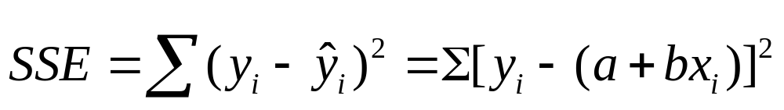

Prediction equation has “least squares” property
Residual sum of squares (i.e., sum of squared errors):
The “least squares” estimates a and b provide the prediction equation with minimum value of SSE
For software tells us SSE = 254.18.
Any other equation, such as has a larger value for SSE.

Slide 19
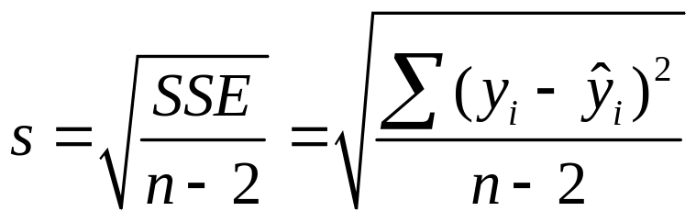
The Linear Regression Model
Recall the linear regression model is E(y) =  +  x (probabilistic rather than deterministic). This says that the mean of the conditional distribution of y at each fixed value of x follows a straight line.
The model has another parameter σ that describes the variability of the conditional distributions; that is, the variability of y values for all subjects having the same x-value.
The estimate of the conditional standard deviation of y is

Slide 20
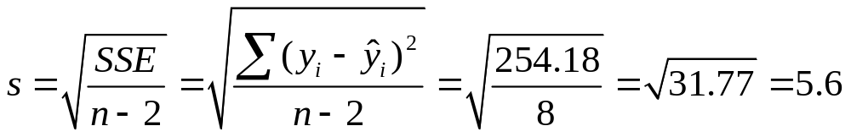
Example: We have SSE = 254.2 based on n = 10.
At any fixed level of x (externalizing behaviors), the estimated standard deviation of anxiety values is 5.6
(Called “Std. Error of the Estimate” in SPSS printout, a very poor label)

Slide 21
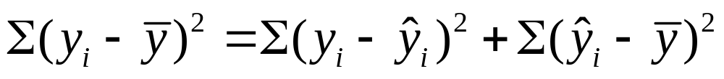
df = n – 2 is degrees of freedom for the estimate s of σ.
(n – 2 because we estimated 2 parameters to get predictions)
The ratio SSE/(n-2) is called the mean square error and often denoted by MSE.
The total sum of squares about the sample mean of y decomposes into the sum of the residual (error) sum of squares and the regression sum of squares
TSS = SSE + Regression SS
We’ll see that regression is more effective in predicting y using x when SSE is relatively small, regression SS is relatively large.

Slide 22
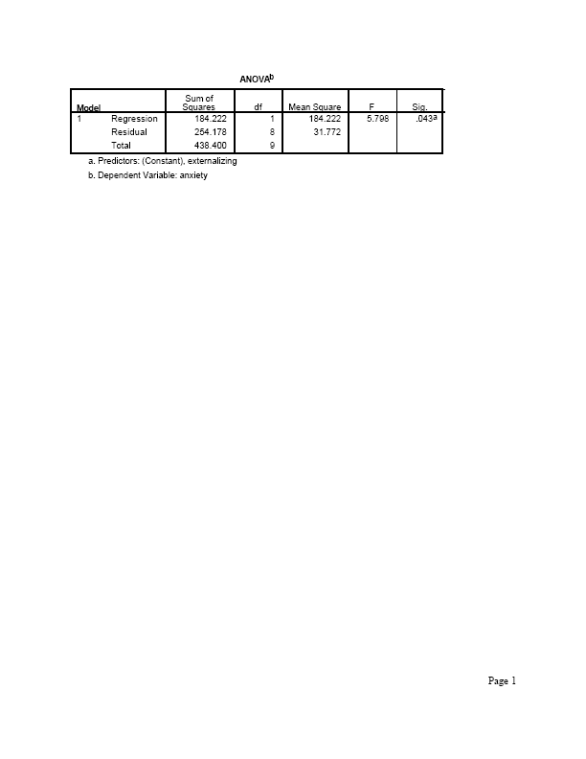
Software shows sums of squares in an “ANOVA” (analysis of variance) table

Slide 23
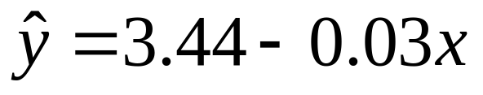
Example: (text, p. 267, study in undergraduate research journal by student at Indiana Univ. of South Bend)
Sample of 50 college students in an introductory psychology course reported y = high school GPA and x = weekly number of hours watching TV
The study reported
Software reports:
----------------------------------------------------------------------------
Sum of Squares df Mean Square
Regression 3.63 1 3.63
Residual 11.66 48 .24
Total 15.29 49
-----------------------------------------------------------------------------

Slide 24
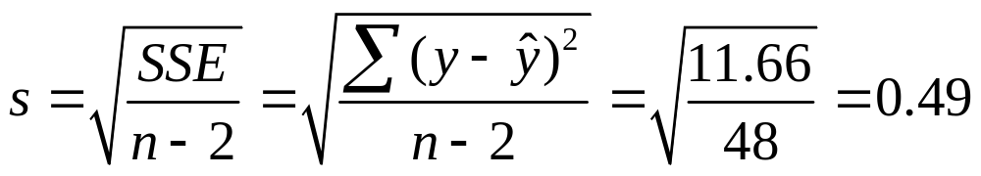

The estimate of the conditional std dev is
i.e., predict GPA’s vary around 3.44 – 0.03x with a standard deviation of 0.49
e.g., at x = 10 hours of TV watching, conditional dist of GPA is estimated to have mean of
3.44 – 0.03(10) = 3.14
and a standard deviation of 0.49.
Note: Conditional std. dev. s differs from marginal std. dev. of y, which we studied in Chap. 3 and is based on variability about
and ignores x in describing variability of y

Slide 25

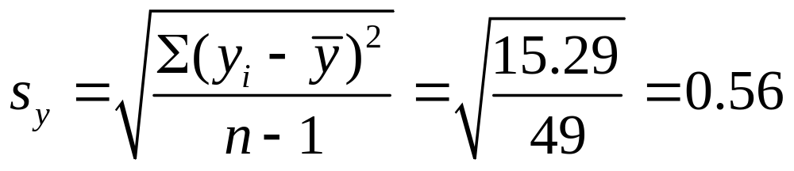
Example: y = GPA, x = TV watching
We found s = 0.49 for estimated conditional standard deviation of GPA
Estimated marginal standard deviation of GPA is
Normally cond. std. dev. s < marginal std. dev. s_{y}
How can they be dramatically different?
(picture)

Slide 26
Measuring association: The correlation
Slope of regression equation describes the direction of association between x and y, but…
  The magnitude of the slope depends on the units of the variables
  The correlation is a standardized slope that does not depend on units
  Correlation r relates to slope b of prediction equation by
r = b(s_{x}/s_{y})
where s_{x} and s_{y} are sample standard deviations
of x and y.

Slide 27
Properties of the correlation
r is standardized slope in sense that r reflects what b equals if s_{x} = s_{y}
-1 ≤ r ≤ +1, with r having same sign as b
r = 1 or -1 when all sample points fall exactly on prediction line, and r describes strength of linear association
r = 0 when b = 0 (can happen when assoc., but not linear)
The larger the absolute value, the stronger the assoc.

Slide 28
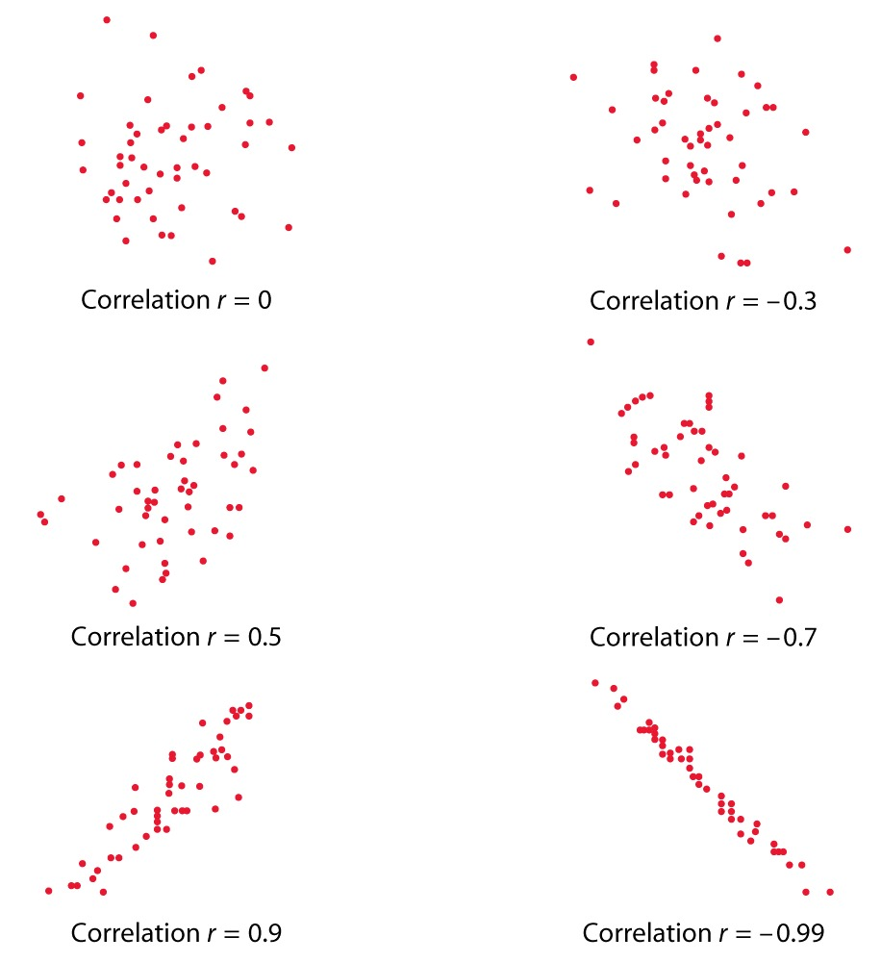

Slide 29
Examples
For y = anxiety and x = externalizing behavior,
= 18.41 + 1.67x, and s_{x} = 2.7, s_{y} = 7.0.
The correlation equals
r = b(s_{x}/s_{y}) = 1.67(2.7/7.0) = 0.648
(moderate positive association)
For y = high school GPA and x = TV watching, we’ll see that r = - 0.49 (moderate negative association)
Beware: Prediction equation and r can be sensitive to outliers (Recall OECD data and effect of Luxembourg observation)

Slide 30
Correlation implies that predictions regress toward the mean
When x goes up 1, predicted y changes by b
When x goes up s_{x,} the predicted y changes by
s_{x}b = rs_{y}
A 1 standard deviation increase in x corresponds to predicted change of r standard deviations in y.
y is predicted to be “closer” to its mean than x is to its mean; i.e., there is regression toward the mean (Francis Galton 1885)
Example: x = parent height, y = child height

Slide 31
Be careful not to be fooled by effects that merely represent regression toward the mean.
Examples:
Exercise 9.50 on effect of special tutoring for students who do poorly on midterm exam
Exercise 9.51 how the lightest readers tend to read more at a later time, the heaviest readers tend to read less at a later time.

Slide 32
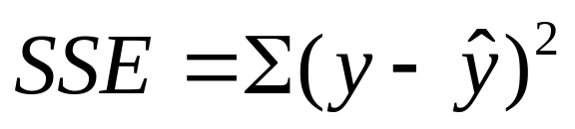
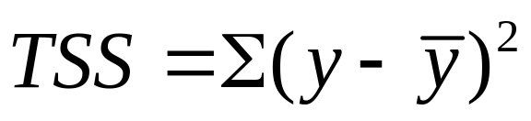
r² ⁼ proportional reduction in error
When we use x in the prediction equation to predict y, a summary measure of prediction error is
sum of squared errors
When we predict y without using x, best predictor is sample mean of y, and summary measure of prediction error is
total sum of squares
Predictions using x get “better” as SSE decreases relative to TSS

Slide 33
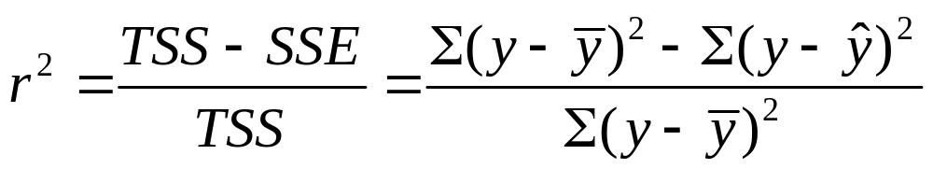
The proportional reduction in error in using x to predict y (via the prediction equation) instead of using sample mean of y to predict y is
i.e., the proportional reduction in error is the square of the correlation!
This measure is sometimes called the coefficient of determination, but more commonly just
“r-squared”

Slide 34
Example: high school GPA and TV watching
Sum of Squares df Mean Square
Regression 3.63 1 3.63
Residual 11.66 48 .24
Total 15.29 49
So, r² = (15.29 – 11.66)/15.29 = 3.63/15.29 = 0.237
There is a 23.7% reduction in error when we use
x = TV watching to predict y = high school GPA.
“23.7% of the variation in high school GPA is explained by TV watching.”
The correlation r is the negative square root of 0.237 (because b < 0), which is r = - 0.49.

Slide 35
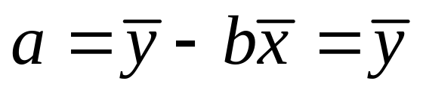
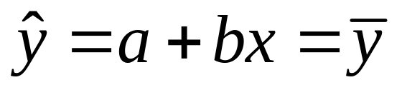
Properties of r²
Since -1 ≤ r ≤ +1, 0 ≤ r² ≤ 1
Minimum possible SSE = 0, in which case r² = 1 and all sample points fall exactly on prediction line
If b = 0, then
so
and so TSS = SSE and r² = 0.
r² does not depend on units, or distinction between x, y

Slide 36
Inference about slope (β) and correlation ()
Assumptions:
The study used randomization in gathering data
The linear regression equation E(y) =  + x holds
The standard deviation σ of the conditional distribution is the same at each x-value.
The conditional distribution of y is normal at each value of x (least important, especially for two-sided inference with relatively large n)

Slide 37
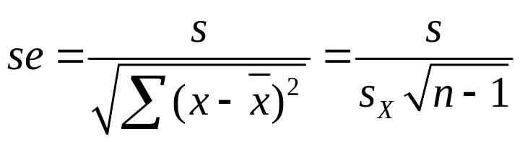
Test of independence of x and y
Parameter: Population slope in regression model (β)
Estimator: Least squares estimate b
Estimated standard error:
decreases (as usual) as n increases
H₀: independence is H₀:  = 0
H_{a} can be two-sided H_{a}:  ≠ 0
or one-sided, H_{a}:  > 0 or H_{a}:  < 0
Test statistic t = (b – 0)/se, with df = n – 2

Slide 38
Example: Anxiety/externalizing behavior revisited
From SPSS output below, t = 1.666/0.692 = 2.41,
df = n – 2 = 10 - 2 = 8, two-sided P-value = 0.043.
Considerable evidence against H₀:  = 0. It appears there is positive association in population between externalizing behaviors and feelings of anxiety (a CI will show this).
For H_{a}:  > 0, P-value = right-tail probability above
t = 2.41, which is 0.043/2 = 0.02.
(Note: “Standardized coeff.” in a bivariate analysis is the correlation, not “beta”!)

Slide 39
Confidence interval for slope 
A CI for  has form b ± t(se)
where t-score has df = n-2 and is from t-table with half the error probability in each tail. (Same se as in test)
Example: b = 1.666, se = 0.692
With df = 8, for 95% CI, t-score = t_{0.025} = 2.306
95% CI for  is 1.666 ± 2.306(0.692), or (0.07, 3.26).
We conclude that association in population is positive, with slope in this range (wide CI because n so small)
(Recall y = anxiety has mean = 29, std. dev. = 7
x = externalizing behavior has mean = 6.6, std. dev. = 2.7)

Slide 40
What is effect of 3-unit increase in x = externalizing behavior?
(nearly a standard deviation increase in x)
Estimate is now 3b, which has 3(se), and we have 3b ± 3t(se), which is 3(0.07, 3.26) = (0.2, 9.8).
Conclusion of two-sided test about H₀:  = 0 is consistent with conclusion of corresponding CI, with error prob.  that is the significance level of test.
Example: Two-sided P-value = 0.04, so reject H₀:  = 0 at 0.05 level and conclude there is an association. Likewise, 95% CI for  does not contain 0 as a plausible value for .

Slide 41
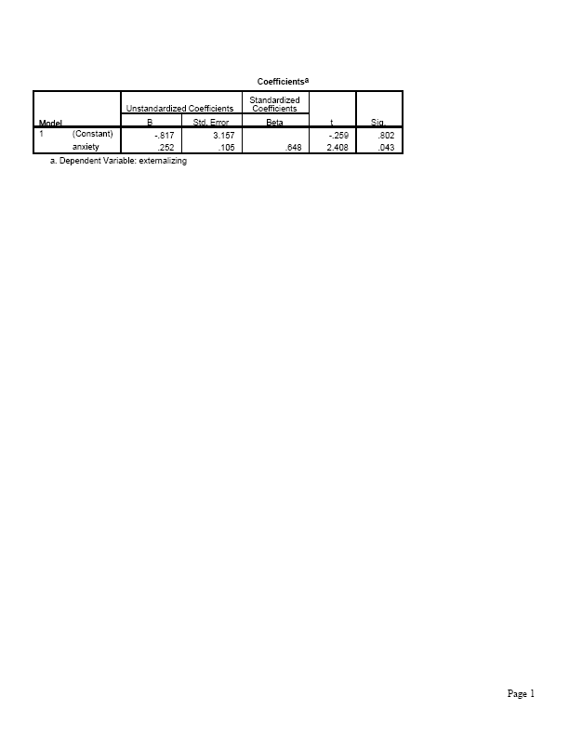
What if reverse roles of variables?
(Now, y = externalizing behavior, x = anxiety
Prediction equation changes (-0.82 + 0.25x)
Correlation stays same (r = 0.648)
Result of t test is same (t = 2.41, P = 0.043 two-sided)
(How about bivariate analyses of categorical var’s? What changes and what stays the same?)

Slide 42
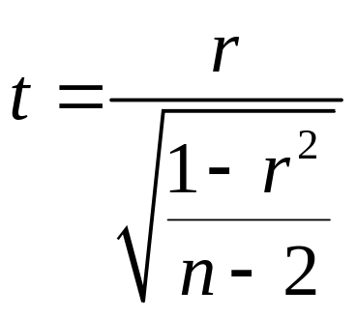
Some comments
Equivalent test of independence uses H₀:  = 0, where  is popul. correlation that sample correlation r estimates (Useful when no distinction between response, explanatory variables)
Test statistic
Example: r = 0.648, n = 10, so t = 0.648/0.269 = 2.41, df = 8.
P-value = 0.043 for H_{a} :  ≠ 0. (This formula is useful for showing that |t| increases, P-value decreases, as |r| and/or n increase.)
CI for  more complex because r has a highly skewed sampling distribution when || gets closer to 1.0 (text, exercise 9.64)

Slide 43
Linear regression is a model: We don’t truly expect exactly a linear relation with constant variability, but it is often a good and simple approximation in practice.
Extrapolation beyond observed range of x-values dangerous. For y = high school GPA and x = weekly hours watching TV, . If observe x between 0 and 30, say, does not make sense to plug in x = 100 and get predicted GPA = 0.44.
Observations are very influential if they take extreme values (small or large) of x and fall far from the linear trend the rest of the data follow. These can unduly affect least squares results.

Slide 44
Example of effect of outlier
For data on y = anxiety and x = externalizing behavior, subject 5 had x = 11, y = 42. Suppose data for that subject had been incorrectly entered in data file as x = 110 and y = 420.
Instead of = 18.41 + 1.67x, we get
= 5.14 + 3.76x
Instead of r = 0.64, get r = 0.998
Suppose x entered OK but y entered as 420.
Then = -109.1 + 26.7x, and r = 0.58.

Slide 45
Correlation biased downward if only narrow range of x-values sampled. (see picture for why this happens)
Thus, r mainly useful when both X and Y randomly sampled.
Example (p. 286): How strong is association between x = SAT exam score and y = college GPA at end of second year of college? We’ll find a very weak correlation if we sample only Harvard students, because of the very narrow range of x-values.
An alternative way of expressing the regression model
E(y) =  + x
is y =  + x + ,
where  is a population residual (error term) that varies around 0 (see p. 287 of text)

Slide 46
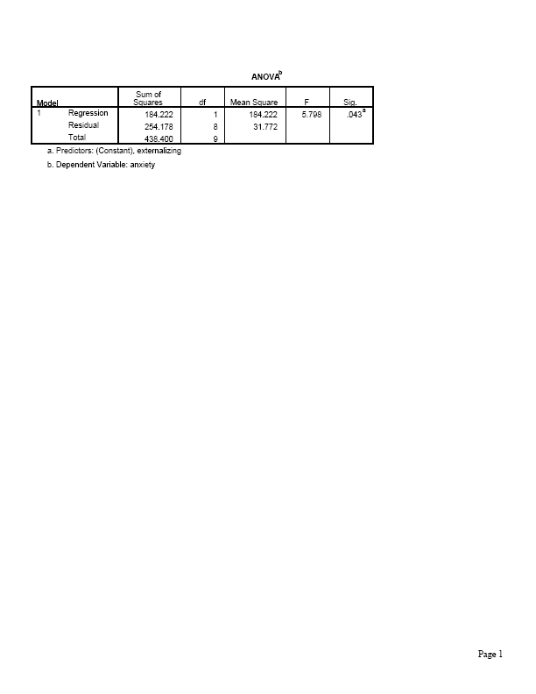
Software reports SS values, test results in an ANOVA (analysis of variance) table
The F statistic in the ANOVA table is the square of the t statistic for testing H₀:  = 0, and it has the same P-value as for the two-sided t test. This is a more general statistic needed when a hypothesis contains more than one regression parameter (Chapter 11).

Slide 47
Some review questions for Chapter 9
What do we mean by a regression model?
What is a residual, and how do residuals relate to summarizing regression prediction errors, “least squares,” r-squared?
3. What is the effect of units of measurement on least squares prediction equation, correlation, inferences such as t test about slope? What’s effect of interchanging x and y?
4. In what sense is the correlation a standardized slope?
How can you interpret it in this way, and how can you interpret it in terms of the effect of a standard deviation change in x?

Slide 48
What is meant by “regression toward the mean” and what are some of its implications? (What would have to happen for there to be no regression toward the mean?)
6. When is the correlation misleading as a summary measure of association for quantitative variables? Why?
7. What is meant by a “conditional distribution” (quantitative, categorical cases)? What is a “conditional” standard deviation and when is it much less than a “marginal” standard deviation?
8. How do you do a test of independence for (a) two quantitative variables? (b) two categorical variables? (c) a quantitative and a categorical variable?
9. If for a given data set, predictor x₁ has a stronger correlation with y than does x₂ then how do their SSE values compare? How do their TSS values compare?

